Slide 1
CCNA (200-125)
High Availability and Redundancy
(HSRP, VRRP, GLBP)
Instructor:
Muhammad Naeem
(MSIT/RHCE/CCNP/CCNA/MCSE)
Cell: 0345-5238281
E-Mail: mna571@yahoo.com

Slide 2
Objectives:
High Availability
Layer 3 Redundancy Protocols
HSRP (Hot Standby Router Protocol)
VRRP (Virtual Router Redundancy Protocol)
GLBP (Global Load Balancing Protocol)

Slide 3
Implementing High Availability
To achieve high network availability, the following network components are required:
Reliable, fault-tolerant network devices— Hardware and software reliability to automatically identify and overcome failures.
Device and link redundancy— Entire devices may be redundant or modules within devices may be redundant. Links may also be redundant.
Resilient network technologies— Intelligence that ensures fast recovery around any device or link failure.
Optimized network design— Well-defined network topologies and configurations designed to ensure that there is no single point of failure.
Best practices— Documented procedures for deploying and maintaining a robust e-commerce network infrastructure.
Change control— Better control over changes made to network devices and maintenance of documentation regarding those changes.

Slide 4
Router Redundancy
Packet Forwarding Review
Host communication in a local subnet is generated by ARP Request & ARP Reply
In case of diff. subnet it uses proxy ARP(gateway MAC addr) for communication
So gateway availability is must. Several protocols are used to allow multiple routing devices to share a common gateway address.

Slide 5
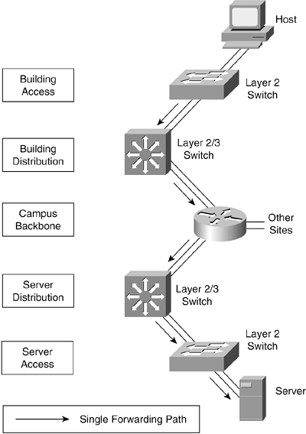
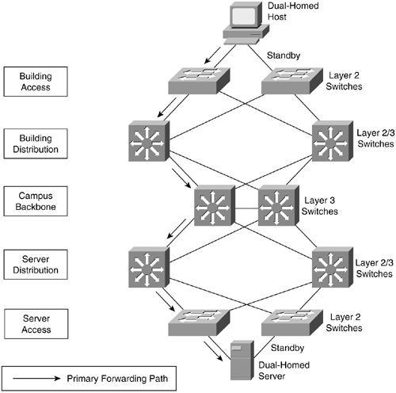
Single Forwarding Path vs Redundancy

Slide 6
Implementing High Availability
The network devices that provide redundancy do not need to be co-located in the same physical location.
This reduces the probability that problems with the physical environment, such as a power outage or other environmental issue, will interrupt service.
Paraphrasing Jim Warner, Network Engineer at UCSC, ‘When adding redundancy, know what you are trying to protect yourself from. It doesn’t help to have redundant devices when there is a power failure, or redundant links when the cables laid in the same conduit.’

Slide 7
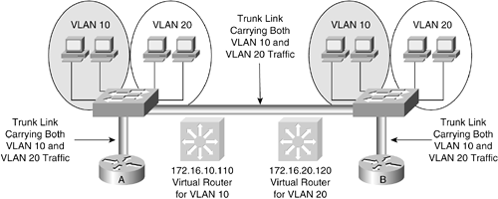
Redundancy can be used for load balancing
HSRP Load Balancing
With appropriate resiliency features combined with careful design and configuration, the traffic load between the respective layers of the network topology (that is, Building Access submodule to Building Distribution sub module) can be shared between the primary and secondary forwarding paths.
Therefore, network-level redundancy can also provide increased aggregate performance and capacity.

Slide 8
Redundancy Protocols
Cisco IOS offers several features to provide a redundant default gateway to end devices.
The redundancy protocol provides the mechanism for determining which router should take the active role in forwarding traffic, and when that role must be taken over by one of the other routers.
The transition from one forwarding router to another is transparent to the end devices.
The following are the default gateway redundancy features supported by Cisco IOS routers and switches:
Hot Standby Routing Protocol (HSRP)
Virtual Router Redundancy Protocol (VRRP)
Gateway Load Balancing Protocol (GLBP)

Slide 9
HSRP (Hot Standby Router Protocol)

Slide 10
HSRP
Cisco Proprietary Protocol
A group of routers function as one virtual router by sharing ONE virtual IP address and ONE virtual MAC address
One (Active) router performs packet forwarding for local hosts
The rest of the routers provide “hot standby” in case the active router fails
Standby routers stay idle as far as packet forwarding from the client side is concerned
Notes:
In an HSRP or VRRP group, one router is elected to handle all requests sent to the virtual IP address. With HSRP, this is the active router. An HSRP group has one active router, at least one standby router, and perhaps many listening routers. A VRRP group has one master router and one or more backup routers.
MHSRP provides 2 different standby interfaces under one interface. But some DHCP server like Cisco Network Registrar has to take responsibility of assigning the default gateway to one of the virtual IP addresses in a round robin fashion.

Slide 11
Hot Standby Routing Protocol
Allow several routers to appear as single gateway IP
Gateway IP for multiple routers is assigned to HSRP group
To be aware of each Router status, the Routers exchange Hello msgs.
Hello msg sent to multicast destination addr: “224.0.0.2 using UDP port 1985”
Hello msg – Sent out every 3sec
HSRP group number can be between 0-255, but some catalyst support only 16 groups.
HSRP groups are locally significant on any interface

Slide 12
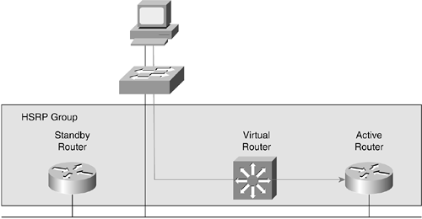
One standby router
The backup router in case the active router fails for the subnet.
In that case, the standby router becomes the active router and starts forwarding traffic destined to the virtual IP address.
One virtual router
The virtual router is not an actual router.
Rather, it is a concept of the entire HSRP group acting as one virtual router as far as hosts on the subnet are concerned.
One active router
The active router forwards traffic destined to the virtual IP address.

Slide 13
ARP Table 172.16.10.110 = 0000.0c07.ac01
My default gateway is 172.16.10.110
172.16.10.169 0010.0b79.5800
172.16.10.110 0000.0c07.ac01
172.16.10.82 0010.f6b3.d000
The host connected to the switch sends the packet destined for the virtual router, but in reality the active router does the packet forwarding.
Note: Additional HSRP member routers— Other routers are neither active nor standby, but they are configured to participate in the same HSRP group.
They monitor the current active and standby routers and transition into one of those roles if the current router fails for the subnet.

Slide 14
ARP Table 172.16.10.110 = 0000.0c07.ac01
My default gateway is 172.16.10.110
172.16.10.110 0000.0c07.ac01
172.16.10.169 0010.0b79.5800
172.16.10.82 0010.f6b3.d000
HSRP Hello’s: Active
The active router assumes and maintains its active role through the transmission of hello messages (default 3 seconds).
The hello interval time defines the interval between successive HSRP hello messages sent by active and standby routers.
The router with the highest standby priority in the group becomes the active router.
The default priority for an HSRP router is 100; however, this option is configurable on a per-standby-group basis.
When the preempt option is not configured, the first router to initialize HSRP becomes the active router

Slide 15
ARP Table 172.16.10.110 = 0000.0c07.ac01
My default gateway is 172.16.10.110
172.16.10.110 0000.0c07.ac01
172.16.10.169 0010.0b79.5800
172.16.10.82 0010.f6b3.d000
HSRP Hello’s: Standby
The second router in the HSRP group to initialize or second highest priority is elected as the standby router.
The function of the standby router is to monitor the operational status of the HSRP group and to quickly assume packet-forwarding responsibility if the active router becomes inoperable.
The standby router also transmits hello messages to inform all other routers in the group of its standby router role and status.

Slide 16
ARP Table 172.16.10.110 = 0000.0c07.ac01
My default gateway is 172.16.10.110
I receive and forward packet sent to the virtual router.
172.16.10.110 0000.0c07.ac01
172.16.10.169 0010.0b79.5800
172.16.10.82 0010.f6b3.d000
The virtual router presents a consistent available router (default gateway) to the hosts.
The virtual router is assigned its own IP address and virtual MAC address; however, the active router acting as the virtual router actually forwards the packets.
Additional HSRP member routers: These routers in listen state monitor the hello messages but do not respond.
Do forward any packets addressed to the routers' IP addresses.
Do not forward packets destined for the virtual router because they are not the active router.

Slide 17
ARP Table 172.16.10.110 = 0000.0c07.ac01
My default gateway is 172.16.10.110
I don’t see Hellos from Active (10 secs), so I will receive and forward packet sent to the virtual router.
New Active Router
172.16.10.110 0000.0c07.ac01
172.16.10.169 0010.0b79.5800
172.16.10.82 0010.f6b3.d000
HSRP Hello’s
HSRP Hello’s: Active
When the active router fails, the other HSRP routers stop receiving hello messages and the standby router assumes the role of the active router.
This occurs when the holdtime expires (default 10 seconds).
Because the new active router assumes both the IP address and virtual MAC address of the virtual router, the end stations see no disruption in service.
The end-user stations continue to send packets to the virtual router's virtual MAC address and IP address where the new active router delivers the packets to the destination.

Slide 18
ARP Table 172.16.10.110 = 0000.0c07.ac01
My default gateway is 172.16.10.110
172.16.10.169 0010.0b79.5800
172.16.10.110 0000.0c07.ac01
172.16.10.82 0010.f6b3.d000
If both the active and standby routers fail:
all routers in the HSRP group contend for the active and standby router roles.
When the active router only fails:
the standby takes over.
If there are other routers participating in the group, those routers then contend to be the new standby router.
The following sections discuss HSRP mechanics in more detail.

Slide 19
HSRP States
Initial state— All routers begin in the initial state. This state is entered via a configuration change or when an interface is initiated. HSRP is not runnning.
Learn state— The router has not determined the virtual IP address, and has not yet seen a hello message from the active router. In this state, the router is still waiting to hear from the active router.
Listen state— The router knows the virtual IP & virtual Mac address, but is neither the active router nor the standby router. All other routers participating in the HSRP group besides the active or standby routers reside in this state.
Speak state— HSRP routers in the speak state send periodic hello messages and actively participate in the election of the active or standby router. The router remains in the speak state unless it becomes an active or standby router.
Standby state— In the standby state, the HSRP router is a candidate to become the next active router and sends periodic hello messages. There must be at least one standby router in the HSRP group.
Active state— In the active state, the router is currently forwarding packets that are sent to the virtual MAC and IP address of the HSRP group. The active router also sends periodic hello messages.
Not all HSRP routers transition through all states. For example, a router that is not the standby or active router does not enter the standby or active states.

Slide 20

HSRP States
HSRP Standby Group 1
Router A
Priority
100
Router B
Priority
50
Initial Initial
All other routers remain in this state.
Listen Listen
Router A does not hear any higher priority than itself, so promotes itself to standby.
Speak Speak
Router B hears that router A has a higher priority, so router B returns to the listen state.
Standby Listen
Router A does not hear an active router, so promotes itself to active.
Active Speak
Standby

Slide 21
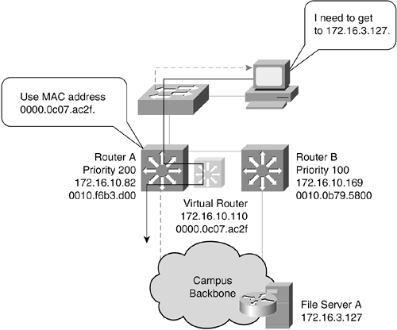
HSRP Group Identifier
Router A has a priority of 200
Router B has a default priority of 100.
Router A assumes the active router role and forwards all frames addressed to the well-known MAC address of 0000.0c07.acxx, where xx is the HSRP group identifier.

Slide 22
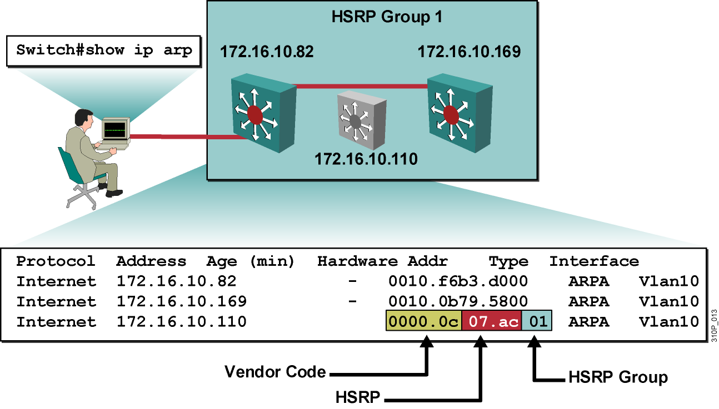
HSRP Group Identifier
If the HSRP group number of router A is 01, the MAC address that corresponds to the virtual IP address is 0000.0c07.ac01.
If the HSRP group number of router A is 2f, the MAC address that corresponds to the virtual IP address is 0000.0c07.ac2f.
The HSRP group number is the standby group number (47) converted to hexadecimal (2f).

Slide 23
Configuring HSRP: Group, Virtual IP
To configure a router as a member of an HSRP standby group, enter this command in interface configuration mode:
(Physical interface or VLAN interface if VLANs are used)
Switch(config-if)#standby group-number ip virtual-ip-address
group-number refers to the HSRP standby group number.
The group number can range from 0 to 255.
virtual-ip-address indicates the virtual IP address of the HSRP group.

Slide 24
Configuring HSRP: Group, Priority
Each standby group has its own active and standby routers.
To set the priority value of a router, enter this command in interface configuration mode:
Switch(config-if)#standby group-number priority priority-value
The priority-value indicates the number that prioritizes a potential standby router.
The range is 0 to 255; the default is 100.
During the election process, the router in an HSRP group with the highest priority becomes the forwarding router.
If several routers have the same priority, the physical IP address of the router's interface is used as a tiebreaker.
The router with the numerically highest IP address wins.

Slide 25
Configuring HSRP Preempt
The standby router automatically assumes the active router role when the active router fails or is removed from service.
This new active router remains the forwarding router even when the former active router with the higher priority regains service in the network.
The former active router can be configured to resume the forwarding router role from a router with a lower priority.
To enable a router to resume the active state after a state change, enter the following command in interface configuration mode:
Switch(config-if)#standby [group-number] preempt [{delay} [minimum delay] [sync delay]]
To remove the interface from preemptive status, enter the following command:
Switch(config-if)#no standby group-number preempt

Slide 26
Configuring HSRP
Router A
interface vlan 10
ip add 172.16.10.82 255.255.255.0
standby 1 priority 200
standby 1 ip 172.16.10.110
standby 1 preempt
Router B
interface vlan 10
ip add 172.16.10.169 255.255.255.0
standby 1 priority 100
standby 1 ip 172.16.10.110
standby 1 preempt

Slide 27
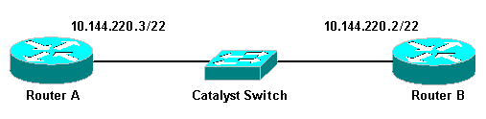
Virtual IP: 10.144.220.1
Active Router
Standby Router
Router A
inter FastEthernet1/0
ip address 10.144.220.3 /22
standby 1 priority 120
standby 1 preempt
standby 1 ip 10.144.220.1
Router B
interface FastEthernet3/0
ip address 10.144.220.2 /22
standby 1 priority 110
standby 1 preempt
standby 1 ip 10.144.220.1

Slide 28
DHCP Request
DHCP Server Reply: Default Gateway = Virtual IP Address
While running HSRP, it is important that the end-user stations do not discover the actual MAC addresses of the routers in the standby group.
Any protocol that informs a host of the router's actual address must be disabled.

Slide 29
Verifying an HSRP Standby Interface
Switch#show running-config
Building configuration...
Current configuration: !
(text deleted)
interface Vlan10
ip address 172.16.10.82 255.255.255.0
no ip redirects
standby 10 ip 172.16.10.110
!
(text deleted)
Using the VLAN ID as the HSRP standby group identifier makes troubleshooting HSRP issues easier.
However, it may not always be possible, because the group identifier can only be specified in the range of 0 to 255.
Note: In the previous examples the group identifier is “1”.
Enabling HSRP on a Cisco router interface automatically disables ICMP redirects to ensure that the actual addresses of the participating HSRP routers are not discovered.

Slide 30
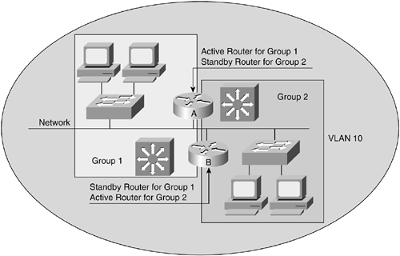
HSRP Load Balancing

Slide 31
HSRP Load Balancing
To facilitate load sharing, a single router may be a member of multiple HSRP standby groups on a single segment or VLAN.
Configuring multiple standby groups further enables redundancy and load sharing within networks and allows redundant routers to be more fully utilized.
While a router is actively forwarding traffic for one HSRP group, it can be in the standby or listen state for another group.
Each standby group emulates a single virtual router.

Slide 32
HSRP Load Balancing
Note: There can be up to 255 standby groups on any VLAN or interface.
Increasing the number of groups in which a router participates increases the management load on the router and may affect the performance of the router for very large numbers of HSRP groups.
Both router A and router B are members of groups 1 and 2.
However, router A is the active forwarding router for group 1 and the standby router for group 2.
Router B is the active forwarding router for group 2 and the standby router for group 1.

Slide 33
HSRP Load Balancing
Two HSRP-enabled routers participate in two separate VLANs using Inter-Switch Link (ISL) or 802.1Q.
Trunking allows users to configure HSRP redundancy between multiple routers to eliminate situations in which a single point of failure causes traffic interruptions.

Slide 34
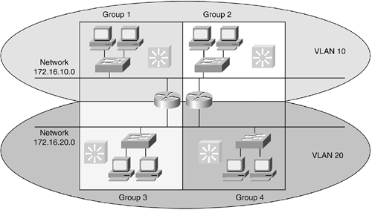
HSRP Load Balancing
Routers or Layer 3 switches can belong to multiple groups within multiple VLANs.
As members of multiple hot standby groups, routers can simultaneously provide redundant backup and perform load sharing across different IP subnets.

Slide 35
Timers
Both the hellotime and the holdtime parameters are configurable.
To configure the time between hello messages and the time before other group routers declare the active or standby router to be nonfunctioning, enter this command in interface configuration mode:
standby group-number timers hellotime holdtime
The value of the hellotime parameter is in seconds, 3 seconds being the default value.
The hellotime parameter value varies from 1 to 255.
The value of the holdtime parameter is also in seconds, 10 seconds being the default value.
The holdtime parameter value varies from 1 to 255.
To reinstate the default standby timer values, enter the following command:
no standby group-number timers

Slide 36
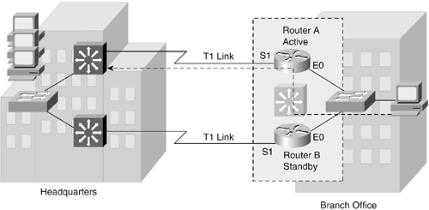
Configuring HSRP Interface Tracking
Active Router
In some situations, the status of an interface directly affects which router needs to become the active router.
This is particularly true when each of the routers in an HSRP group has a different path to resources within the campus network.
Router A and router B reside in a branch office.
These two routers each support a T1 link to headquarters.
Router A has the higher priority and is the active forwarding router for standby group 47.
Router B is the standby router for that group.
Routers A and B are exchanging hello messages through their E0 interfaces.

Slide 37
Configuring HSRP Interface Tracking
Active Router
Router A sends ICMP Redirect to Host, pointing it to Router B.
X
Host now sends packets to Router B.
Primary T1 link experiences a failure.
Without HSRP enabled, router A would detect the failed link and send an ICMP redirect to router B.

Slide 38
Configuring HSRP Interface Tracking
Active Router
Router A still sends HSRP Hello’s.
X
Hosts continue to send packets to Router A.
However, when HSRP is enabled, ICMP redirects are disabled.
Therefore, neither router A nor the virtual router sends an ICMP redirect.
Although the S1 interface on router A is no longer functional, router A still sends hello messages out interface E0, indicating that router A is still the active router.
Packets sent to the virtual router for forwarding to headquarters cannot be routed.

Slide 39
Configuring HSRP Interface Tracking
Active Router
Router A still sends HSRP Hello’s.
X
Hosts continue to send packets to Router A.
Interface tracking enables the priority of a standby group router to be automatically adjusted based on availability of the other interfaces on that router.

Slide 40
Configuring HSRP Interface Tracking
Active Router
Router A tracks S1 and automatically decrements its priority and stops sending hello messages.
X
Hosts now send packets to Router B.
Router B assumes Active role after holdtime.
The E0 interface on router A tracks the S1 interface.
If the link between the S1 interface and headquarters fails, the router automatically decrements its priority on that interface and stops transmitting hello messages out interface E0.
Router B assumes the active router role when no hello messages are detected for the specific holdtime period.

Slide 41
Router A
interface Ethernet0
ip address 171.16.6.5 /24
no ip redirects
standby 1 priority 105
standby 1 preempt
standby 1 ip 171.16.6.100
standby 1 track Serial1
interface Serial1
ip address 171.16.2.5 /24
Router B
interface Ethernet0
ip address 171.16.6.6 /24
no ip redirects
standby 1 priority 100
standby 1 preempt
standby 1 ip 172.16.6.100
standby 1 track Serial1
interface Serial1
ip address 171.16.7.6 /24

Slide 42
Before Failure
RouterA#show standby
Ethernet0 - Group 1
Local state is Active, priority 105, may preempt
Hellotime 3 holdtime 10
Next hello sent in 00:00:01.028
Hot standby IP address is 171.16.6.100 configured
Active router is local
Standby router is 171.16.6.6 expires in 00:00:08
Tracking interface states for 1 interface, 1 up:
Up Serial1

Slide 43
Before Failure
RouterB#show standby
Ethernet0 - Group 1
Local state is Standby, priority 100, may preempt
Hellotime 3 holdtime 10
Next hello sent in 00:00:00.772
Hot standby IP address is 171.16.6.100
Active router is 171.16.6.5 expires in 00:00:09
Standby router is local
Standby virtual mac address is 0000.0c07.ac01
Tracking interface states for 1 interface, 1 up:
Up Serial1

Slide 44
After Failure
RouterA#show standby
Ethernet0 - Group 1
Local state is Standby, priority 95, may preempt
Hellotime 3 holdtime 10
Next hello sent in 00:00:01.028
Hot standby IP address is 171.16.6.100 configured
Active router is 171.16.6.6 expires in 00:00:08
Standby router is local
Tracking interface states for 1 interface, 0 up:
Down Serial1

Slide 45
After Failure
RouterB#show standby
Ethernet0 - Group 1
Local state is Active, priority 100, may preempt
Hellotime 3 holdtime 10
Next hello sent in 00:00:00.772
Hot standby IP address is 171.16.6.100
Active router is local
Standby router is 171.16.6.5 expires in 00:00:09
Standby virtual mac address is 0000.0c07.ac01
Tracking interface states for 1 interface, 1 up:
Up Serial1

